Slide 1
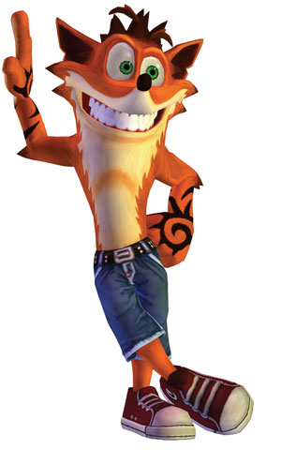
A crash course in exceptions 2: Exceptions and test
Software Test

Slide 2
Exceptions and test
Exceptions must also be tested
Exceptions are part of the ”contract” for using a class
If you do so-and-so, this particular exception will be thrown
Create test cases that verify that exceptions occur when they should

Slide 3
Exceptions and test
Combined Act/Assert – it is necessary to Assert directly on the Act!
//Testing using oldfashioned Assert.Throws<>
[Test]
public void TestThatThrowsException2()
{
uut = new UUT();
uut.SetUpScenario();
Assert.Throws<MyException>( () => uut.StuffThatThrowsException());
}
Function/method with zero parameters, defined with a lambda expression

Slide 4
Exceptions and test
// Testing using constraints
[Test]
public void TestThatThrowsException3()
{
uut = new UUT();
uut.SetUpScenario();
Assert.That(() => uut.StuffThatThrowsException(), Throws.TypeOf<MyException>());
}

Slide 5
Exceptions and test
// Testing for values in the exception using constraints
[Test]
public void TestThatThrowsException3()
{
uut = new UUT();
uut.SetUpScenario();
Assert.That(() => uut.StuffThatThrowsException(),
Throws.TypeOf<MyException>().With.Property("Value").EqualTo(42));
}

Slide 6
Exceptions and test
// Testing on expected values in the exception
// Using oldfashioned Assert.Catch is more readable than the constraint version
[Test]
public void TestThatThrowsException4()
{
uut = new UUT();
uut.SetUpScenario();
var ex =
Assert.Catch<ExceptionWithValue>( () => uut.StuffThatThrowsException());
Assert.That(ex.Value, Is.EqualTo(42));
}

Slide 7
Exceptions and test
// Old fashioned, where is the failure???
[Test]
[ExpectedException(typeof(MyException))]
public void TestThatThrowsException1()
{
uut = new UUT();
uut.SetUpScenario();
uut.StuffThatThrowsException()
}
OBSOLETE !
This attribute for testing Exceptions in NUnit is no longer available for the reason indicated in the comment. If there is more than one line of code in the test, it will not be clear, if the exception was actually thrown from the expected line and not from one of the other lines, when the test passes.

